Slide 1
Binary Search
Assume that keys are already sorted in an array (e.g., ascending order) and the array size is a power of 2
Divide
Compare the query x with the middle element in the sorted array
Conquer
Recursively process one of the subarrays depending on the comparison
Combine
We don’t have it in this example
T(n)=T(n/2)+ θ(1)
Using Master Method: Case 2 → T(n)= θ(log n)

Slide 2
Power Problem
Problem: For a given integer number n and x, compute x^{n}?
It can be done linear: Naïve approach
Just multiple x for n times
O(n)
How about a better algorithm?
Based on Divide and Conquer…
Any ideas?

Slide 3
Divide and Conquer for the Power Problem
Do the multiplication for x^{n/2}
If n is even, then x^{n} = x^{n/2} * x^{n/2}
If n is odd, then x^{n} = x^{(n-1)/2} * x^{(n-1)/2} * x
The only work outside of the recursive call is a constant-time multiplication
T(n)=T(n/2) + c → Master Method: Case 2 → T(n)= O(log n)
Compare to naïve approach that takes O(n)

Slide 4
Quick Sort
Array recursively divided into two partitions and recursively sorted
Division based on a pivot
pivot divides the two sub-arrays
All items < pivot placed in sub-array before pivot
All items ≥ pivot placed in sub-array after pivot

Slide 5
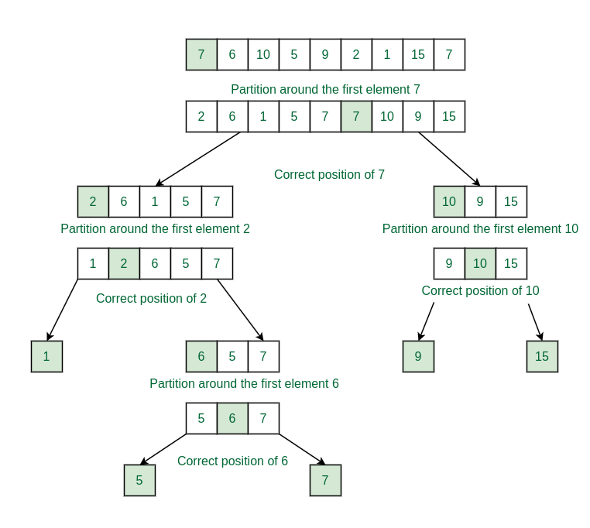
Quick Sort

Slide 6
Quick Sort in D&C Steps
Divide:
Rearrange the elements and split the array into 2 subarrays (based on the pivot item)
Conquer:
Recursively sort the two subarrays
Combine:
None!

Slide 7
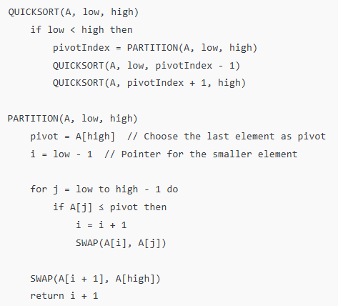
Quick Sort
8 | 9 | 2 | 1 | 4

Slide 8
Complexity Analysis of Quick Sort
The algorithm does not have an every-case time complexity
Worst case analysis:
When the array is already sorted, the array is divided to 1 and n-1
T(n)=T(n-1)+n while n is the time to find the pivot → Complexity is:
Average case analysis:
When the pivot splits the array into two equal halves (or nearly equal)
T(n)=2T(n/2)+n → Complexity is O(n.log n)
O(n²)

Slide 9
Quick Sort Space Complexity
Average-Case Auxiliary Space Complexity:
On average, QuickSort partitions the array into roughly equal halves.
QuickSort is in-place (it swaps elements without using extra arrays), the space required is only for the recursive call stack, which is O(log⁡n)
Worst case Auxiliary Space Complexity:
the space required is for the recursive call stack, which is O(n)

Slide 10
Matrix Multiplication
We know that the naïve matrix multiplication has O(n³) time complexity
Given two n×n matrices A and B, compute their product:
C=A×B where C is also an n×n matrix.

Slide 11

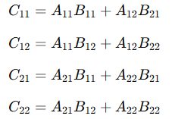
D&C for Matrix Multiplication
Instead of directly multiplying A and B, we split them into smaller submatrices:
Divide: If n=1, multiply directly. Otherwise, divide A and B into four n/2×n/2 submatrices:
Conquer: Compute the four quadrants of C recursively: Each multiplication involves n/2×n/2 matrices, leading to 8 recursive calls.
Combine: Assemble C using the computed submatrices.

Slide 12
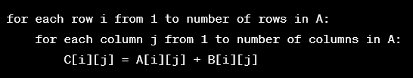
D&C for Matrix Multiplication
Time complexity is 8 recursive multiplications for n/2 and 4 matrix addition:
T(n) = 8T(n/2) + O(n²)
n² is for the matrix addition part
Based on the master theorem the complexity is: O(n³)

Slide 13
Strassen’s Algorithm for Matrix Multiplication
Idea: Use recursive divide-and-conquer technique to reduce the number of multiplications.
P1= a.(f-h)
P2= (a+b).h
P3= (c+d).e
P4= d.(g-e)
P5= (a+d).(e+h)
P6= (b-d).(g+h)
P7= (a-c).(e+f)
p= P5+P4-P2+P6
q= P1+P2
r= P3 + P4
s= P5+P1-P3-P7

Slide 14
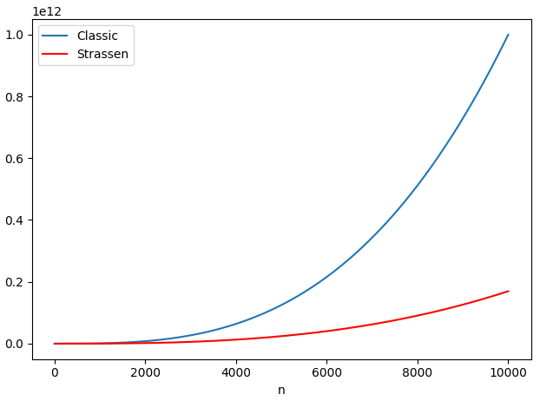
D&C for Strassen’s Algorithm
Divide
Divide A and B matrices
Compute terms for product
Conquer
Compute p1, p2,…, p7
Combine
Compute p, q, r, and u
T(n)=7T(n/2)+n²= O(n^{log7}) = O(n^{2.8})
It is an improvement over the naïve algorithm with O(n³) for large matrices. This makes it more efficient when n is large.

Slide 15
A word of Caution
D & C is not always a better strategy
Look at Quick Sort
The best-case time complexity is O(nlogn) and the worst-case time complexity is O(n²)
When the solution of a sub problem influences the solution to the other sub problem, D&C can’t be applicable effectively
Resource Constraint Scheduling Problem (RCSP)

Slide 16
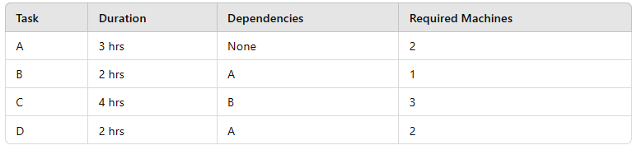
Example of RCSP
Consider scheduling tasks in a factory with limited machines:
If we divide tasks into two groups {A, B} and {C, D}, we face issues:
Task B must follow A, which affects when C can start.
Machine availability changes dynamically based on earlier assignments.
Separate scheduling leads to conflicts or inefficient resource use.

Slide 17
Avoid D&C When…
A problem of size n is divided to two or more sub problems of size similar to n
Usually leads to an exponential time complexity like: T(n)=T(n-1)+n → Complexity is O(n²)
A problem of size n is divided to roughly n sub problems of size n/c (c is a constant)
Leads to O(n^{logn}) which is not good for large n

